Slide 1
The Victorians.
Life as a child.

Slide 2
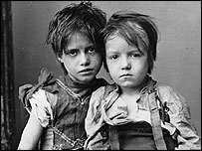
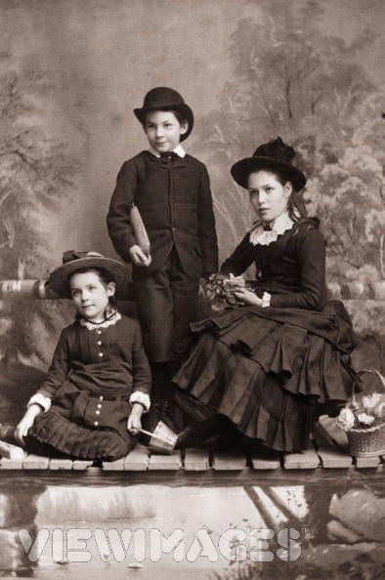
Life was not the same for all children during the Victorian times. The kind of life a child had in the Victorian times depended on its family.
Children from working class families
had few luxuries
ate poor food
worked long hours
lived in damp, filthy conditions.
many children died of disease.
Children from rich families
usually well fed, clean and well clothed
didn't need to work
went on holidays
had expensive toys
had pets such as ponies
Today, every child in Britain has the right to a free education. Many poor Victorian children never went to school. Young children were forced to work as soon as they were old enough to earn money for their families.

Slide 3
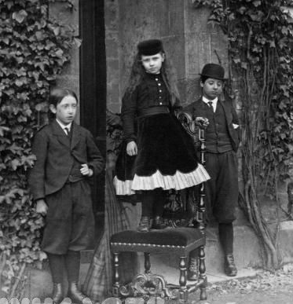
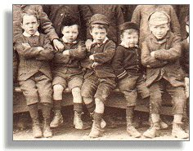
What do you think Victorian children wore?
Boys
1850 short trousers
1860 tweed suit
1880 Norfolk suit
1888 Fauntleroy
No special clothes for play
Girls
1840 pantelettes and crinolines
1870 bustle
No special clothes for play
Poor
No underclothing
2nd/3rd hand clothes (rags)

Slide 4

Toys and games for the nursery
Rocking horse
Dolls house
Tin/lead soldiers
Clockwork trains
Dolls (dressed as grown ups)
Jigsaws, draughts, cards
Older children played with toy theatres (boys) or did needlework (girls)
There were also lots of scientific toys (steam trains, magic lantern, microscope, zoetrope)
Reading was popular.
Poor children played with rag dolls.

Slide 5
Other toys and games
Many games were similar to those played by the Tudors, for example marbles, football, archery and hunting. What activities can you see in these pictures?

Slide 6
Victorian schools
In early Victorian England, most children never went to school at all and grew up unable to read or write. Instead they were sent out to work to earn money for their families. Only children from well off families went to school.

Slide 7
Rich Children
Children from rich families were taught at home by a governess until they were 10 years old. A special room in the house was used, called the school room. When a boy was 10 years old, he went away to a public school like Eton or Harrow. (There were very few schools for girls, until near the end of the Victorian time.) These schools were very rough at the beginning of the century, with fighting, bullying and rioting. They got better during the middle part of the century, and became very popular with parents.

Slide 8
Wealthy girls were mostly educated at home. They were taught by a governess or their mama. They were trained for marriage, nothing more, and were taught ‘accomplishments’ – sketching, playing the piano, singing, embroidery and deportment.
They shouldn’t learn too much, or they would never find a husband!

Slide 9
Poor children.
Poor children went to free charity schools or 'Dame' schools for young children. They were called Dame schools because they were run by old ladies, usually from the front parlour of their house. There were no proper seats, desks or books.
They also went to Sunday Schools which were run by chapels and churches. There they learnt bible stories and were taught to read a little. Children had to be clean and tidily dressed. If they were too dirty or shabby, they were turned away.

Slide 10
There were also 'National Schools‘, built by the church, which taught children reading, writing, arithmetic and religion. There was usually 1 classroom so all children were mixed together. 1 teacher might have 100 pupils! The teacher sat at a high desk, and some of the older pupils helped the younger ones with their lessons. They had to stay behind after school to learn their own lessons.
The teacher was very strict and children were often caned. The building was grim. The classroom was heated by a single open fire, and there were no attractive books or displays.
However, it was still better than the dame school.

Slide 11
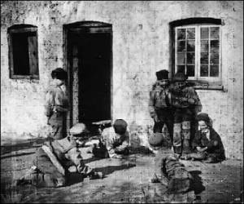
These children are playing in a Victorian school playground. What games are they playing? What is the playground like?

Slide 12
So why did things change?
The Victorians soon realised that it was important for people to be able to read and write and education became more important.
In 1833, the government gave money to schools. Not everyone who ran the schools could read themselves so the standard of education was not very good.
In 1844, Parliament passed a law that meant children working in factories had to have six-half-days schooling every week. 'Ragged Schools' were set up to provide free basic education for orphans and very poor children.
In 1870, Parliament passed the Forster's Education Act. This meant that schools had to be available to all children aged 5 to 12. However, not all these school were free so many could not afford the 'school's pence' each week. As it was not compulsory to attend, many children still didn't go to school. They worked and earned money for the family instead.

Slide 13
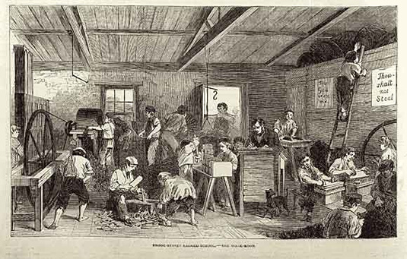
This is a ‘ragged school’. What can you see?

Slide 14
It wasn't until 1880 that schooling became compulsory. All children had to attend a school until they were 10 years old.
In 1889, the school leaving age was raised to twelve, and in 1891, the school's pence fee was abolished and schools became free.

Slide 15
What was a school day like?
The day usually began with prayers and religious instruction. Morning lessons ran from 9a.m. to 12p.m. Children went home for a meal, then returned for afternoon classes from 2p.m. to 5p.m.
Lessons included the three Rs - Reading, WRiting and Dictation, and ARithmetic. These were taught for most of the day, but once a week the children learned geography, history and singing. The girls learned how to sew.
Schools did not teach music or PE in the way that schools do now. Children sometimes did 'drill' in the classroom. Drill was a series of exercises that were done by the side of a desk.

Slide 16
Meanwhile in Wales…
A report was written about the state of education in the country by three English speaking Inspectors.
At the time, everybody in Wales spoke Welsh.
The report became known as ‘The Treason of the Blue Books’ because it was very negative not just about education but about the people and language of Wales.
The report suggested that the Welsh language was a drawback and that everything would improve if English was spoken.

Slide 17
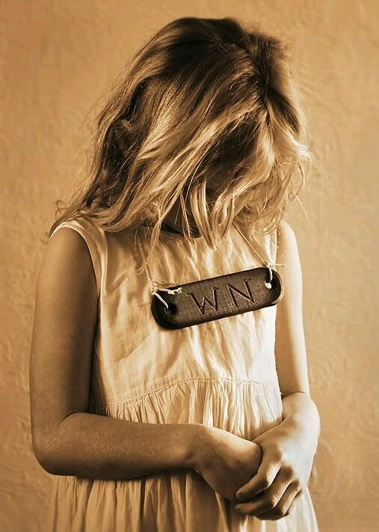
And so the ‘Welsh Not’ was introduced.

Slide 18
The Welsh Not was a piece of wood, inscribed with the letters "WN", that was hung round the necks of children who were caught speaking Welsh in school. The "not" was given to any child overheard speaking Welsh, who would pass it to a different child if overheard speaking Welsh. By the end of the day, the wearer of the "not" would be given a lashing.

Slide 19
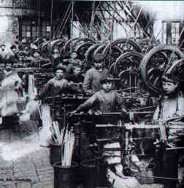
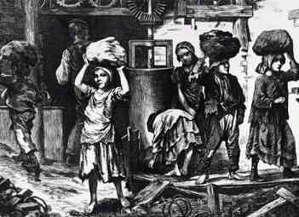
Other important dates.
1847 – Women and children under 18 were banned from working more than 10 hours a day in factories. These changes were led by the Earl of Shaftesbury.
1867 – Children under 8 were no longer allowed to work in factories.

Slide 20
All these changes were called REFORMS.
The laws passed were called REFORM ACTS.

Slide 21
What can you remember?
What were schools like during the Victorian period?
Who went to school at the beginning of Victoria's reign?
Why did this change?
What things were the same about being a Tudor child and a Victorian child?
What things are the same today?

