Slide 1
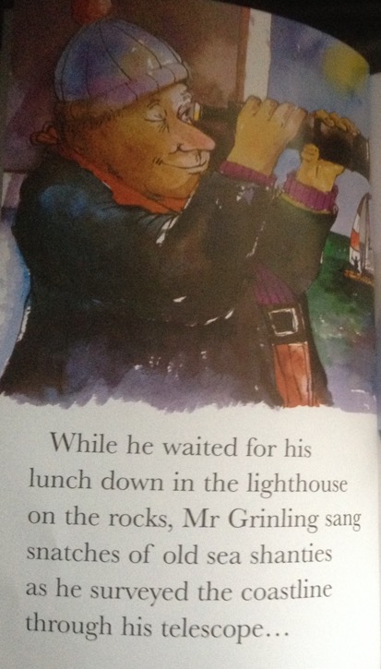

Slide 2
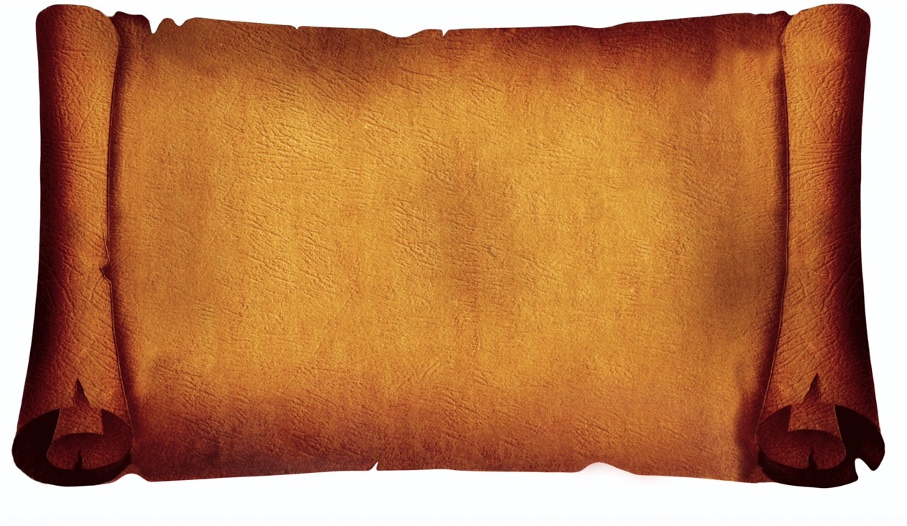
What is a sea shanty?

Slide 3
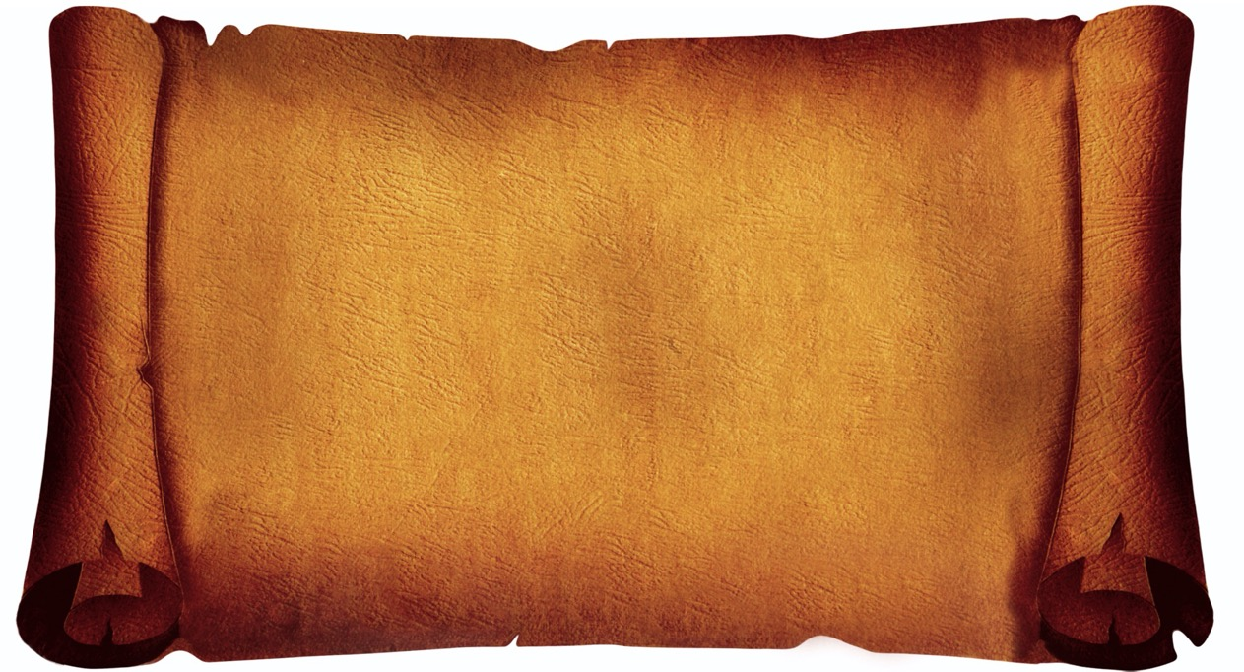
English – sing
Welsh – canu
French – chanty
Notes:
Sea shanties means songs to sing at sea!

Slide 4
Why did sailors sing shanties?

Slide 5
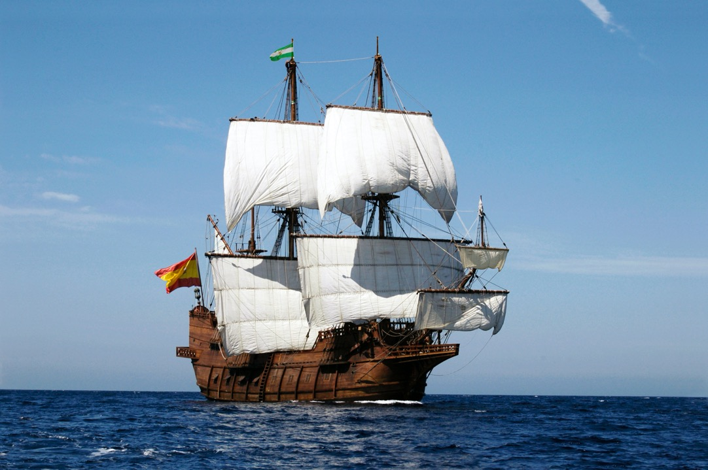
On a ship like this the sailors would have lots of jobs to do…

Slide 6
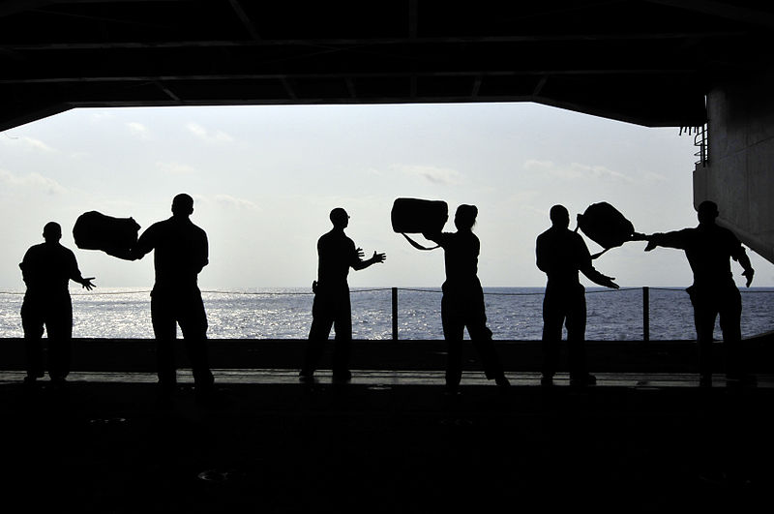
Loading up all of the luggage…

Slide 7
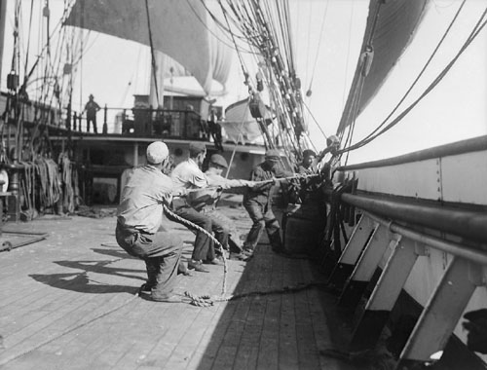
Pulling all
of the sails
up…

Slide 8
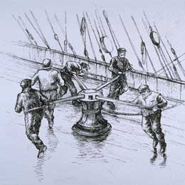

Pulling up the anchor…

Slide 9
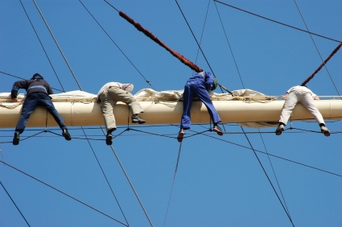
And tying the sails back up after!

Slide 10

These jobs were hard jobs. The sailors needed to work together to get the heavy work done.

Slide 11

To help the sailors work together they would sing sea shanties.

Slide 12
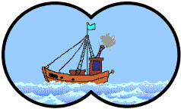

Sons of the sea
Bobbing up and down like this
Sailing the ocean
Bobbing up and down like this
They may build the ships my lads
Bobbing up and down like this
But they can’t beat the boys of the old brigade
Bobbing up and down like this

Slide 13
Pirates are free
Bobbing up and down like this
Searching the ocean
Bobbing up and down like this
They care not for wind or rain
Bobbing up and down like this
For they rob the gold on the Spanish main
Bobbing up and down like this

Slide 14
What shall we do with the grumpy pirate?
What shall we do with the grumpy pirate?
What shall we do with the grumpy pirate? Early in the morning.
Hooray and up she rises, Hooray and up she rises, Hooray and up she rises, Early in the morning.

Slide 15
Do a little jig and make him smile,
Do a little jig and make him smile,
Do a little jig and make him smile, Early in the morning.
What shall we do with the grumpy pirate? What shall we do with the grumpy pirate? What shall we do with the grumpy pirate? Early in the morning.
Hooray and up she rises, Hooray and up she rises, Hooray and up she rises, Early in the morning.

Slide 16


Now it’s YOUR turn!
To write new words for a sea shanty.
To perform the new sea shanty.
I can choose words which make me think of
our topic Land Ahoy.
I can sing my words to the tune of the
sea shanty, keeping in time.

Slide 17
A pirate ship, oh a pirate ship
Going on an exciting trip!
Sailing the ocean, far away
A different adventure every day!
Shiver me timbers, girls and boys!
Walk the plank, it’s ‘ships ahoy!’
Sail the sea and walk the land
Looking for treasure in the sand!

Slide 18
We are pirates, strong and free
Sailing on the open sea!
Splash the oars and hoist the sail
Did you see that big blue whale?
Silver coins and chests of gold
Pots of treasure in the hold
Sailing under an open sky
Raise your hand and say “Aye Aye!”

Slide 19

Every day on the deep, blue sea
It’s a pirate’s life for you and me!
Parrot’s squawking, singing songs
In the sunshine all day long!
Digging in the yellow sand
Captain waving hook and hand
Dig, dig, dig ‘til we catch a cold
To find a chest that’s full of gold!

Slide 20
We are pirates, strong and free
Sailing on the open sea!
Splash the oars and hoist the sail
Did you see that big blue whale?
Silver coins and chests of gold
Pots of treasure in the hold
Sailing under an open sky
Raise your hand and say “Aye Aye!”

