Slide 1
Observing, Concluding, I wonder …?
PICTURE | OBSERVING What can you see ? Evidence ? What do you know from the picture ?
I wonder...? When ? Where ? Who ? | What conclusions have you come to ?

Slide 2
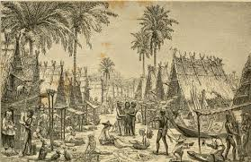
Observing, Concluding, I wonder …?
 | Observe
I wonder...? | Conclusion

Slide 3
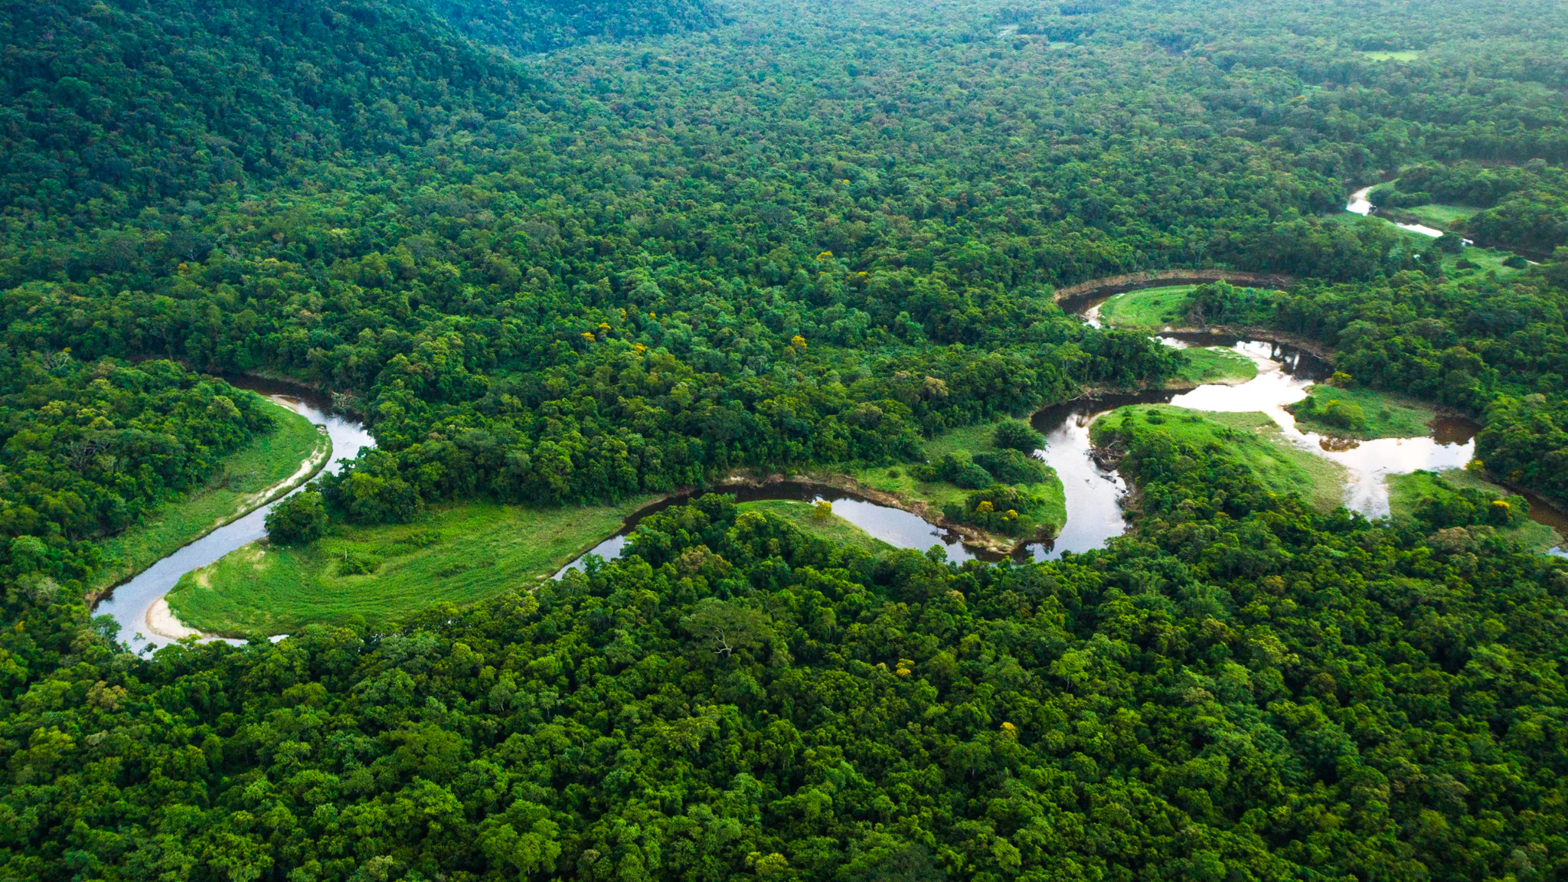
Observing, Concluding, I wonder …?
 | Observe
I wonder...? | Conclusion

Slide 4
Observing, Concluding, I wonder …?
 | Observe
I wonder...? | Conclusion

