Slide 1
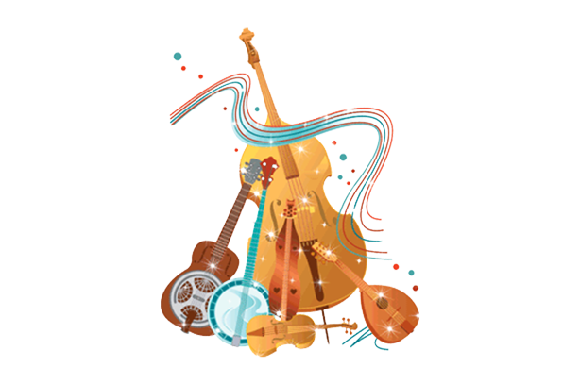
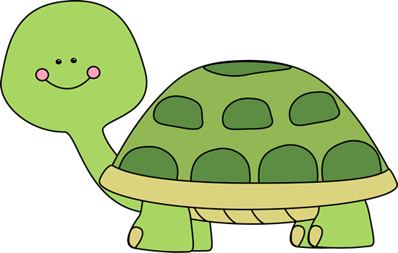
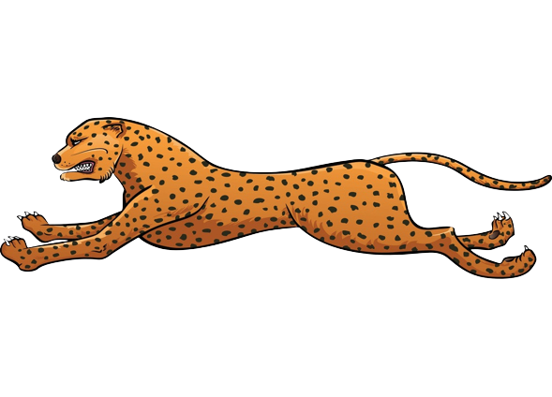
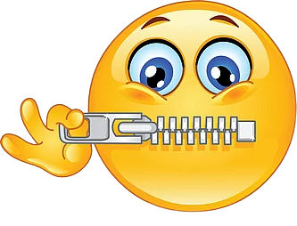
Responding to the music
of the amazon
Instruments | Tempo | Dynamic
Rhythm- long/slow notes, smoth, jerky ??

Slide 3
Excellent Elements
Good Elements
Need Improvement

