Slide 1

Cuthbert Taylor
Biography

Slide 2

Cuthbert Taylor
Cuthbert Taylor was a famous boxer who was born in Wales. He was known for his exceptional skills and dedication to the sport. Taylor's boxing career began at a young age, and he quickly rose to fame due to his extraordinary talent and hard work.

Slide 3
Taylor's achievements
Throughout his career, Cuthbert Taylor won a number of boxing championships, demonstrating his expertise in the ring. He was admired by many for his playfulness and determination to succeed.

Slide 4
Preparation
Plan your hero's biography using a planning method of your choice. Here is an example:

Slide 5

Order of events in his life
Family
Adjectives to describe
Work
Lived
Achievements
Appearance

Slide 6


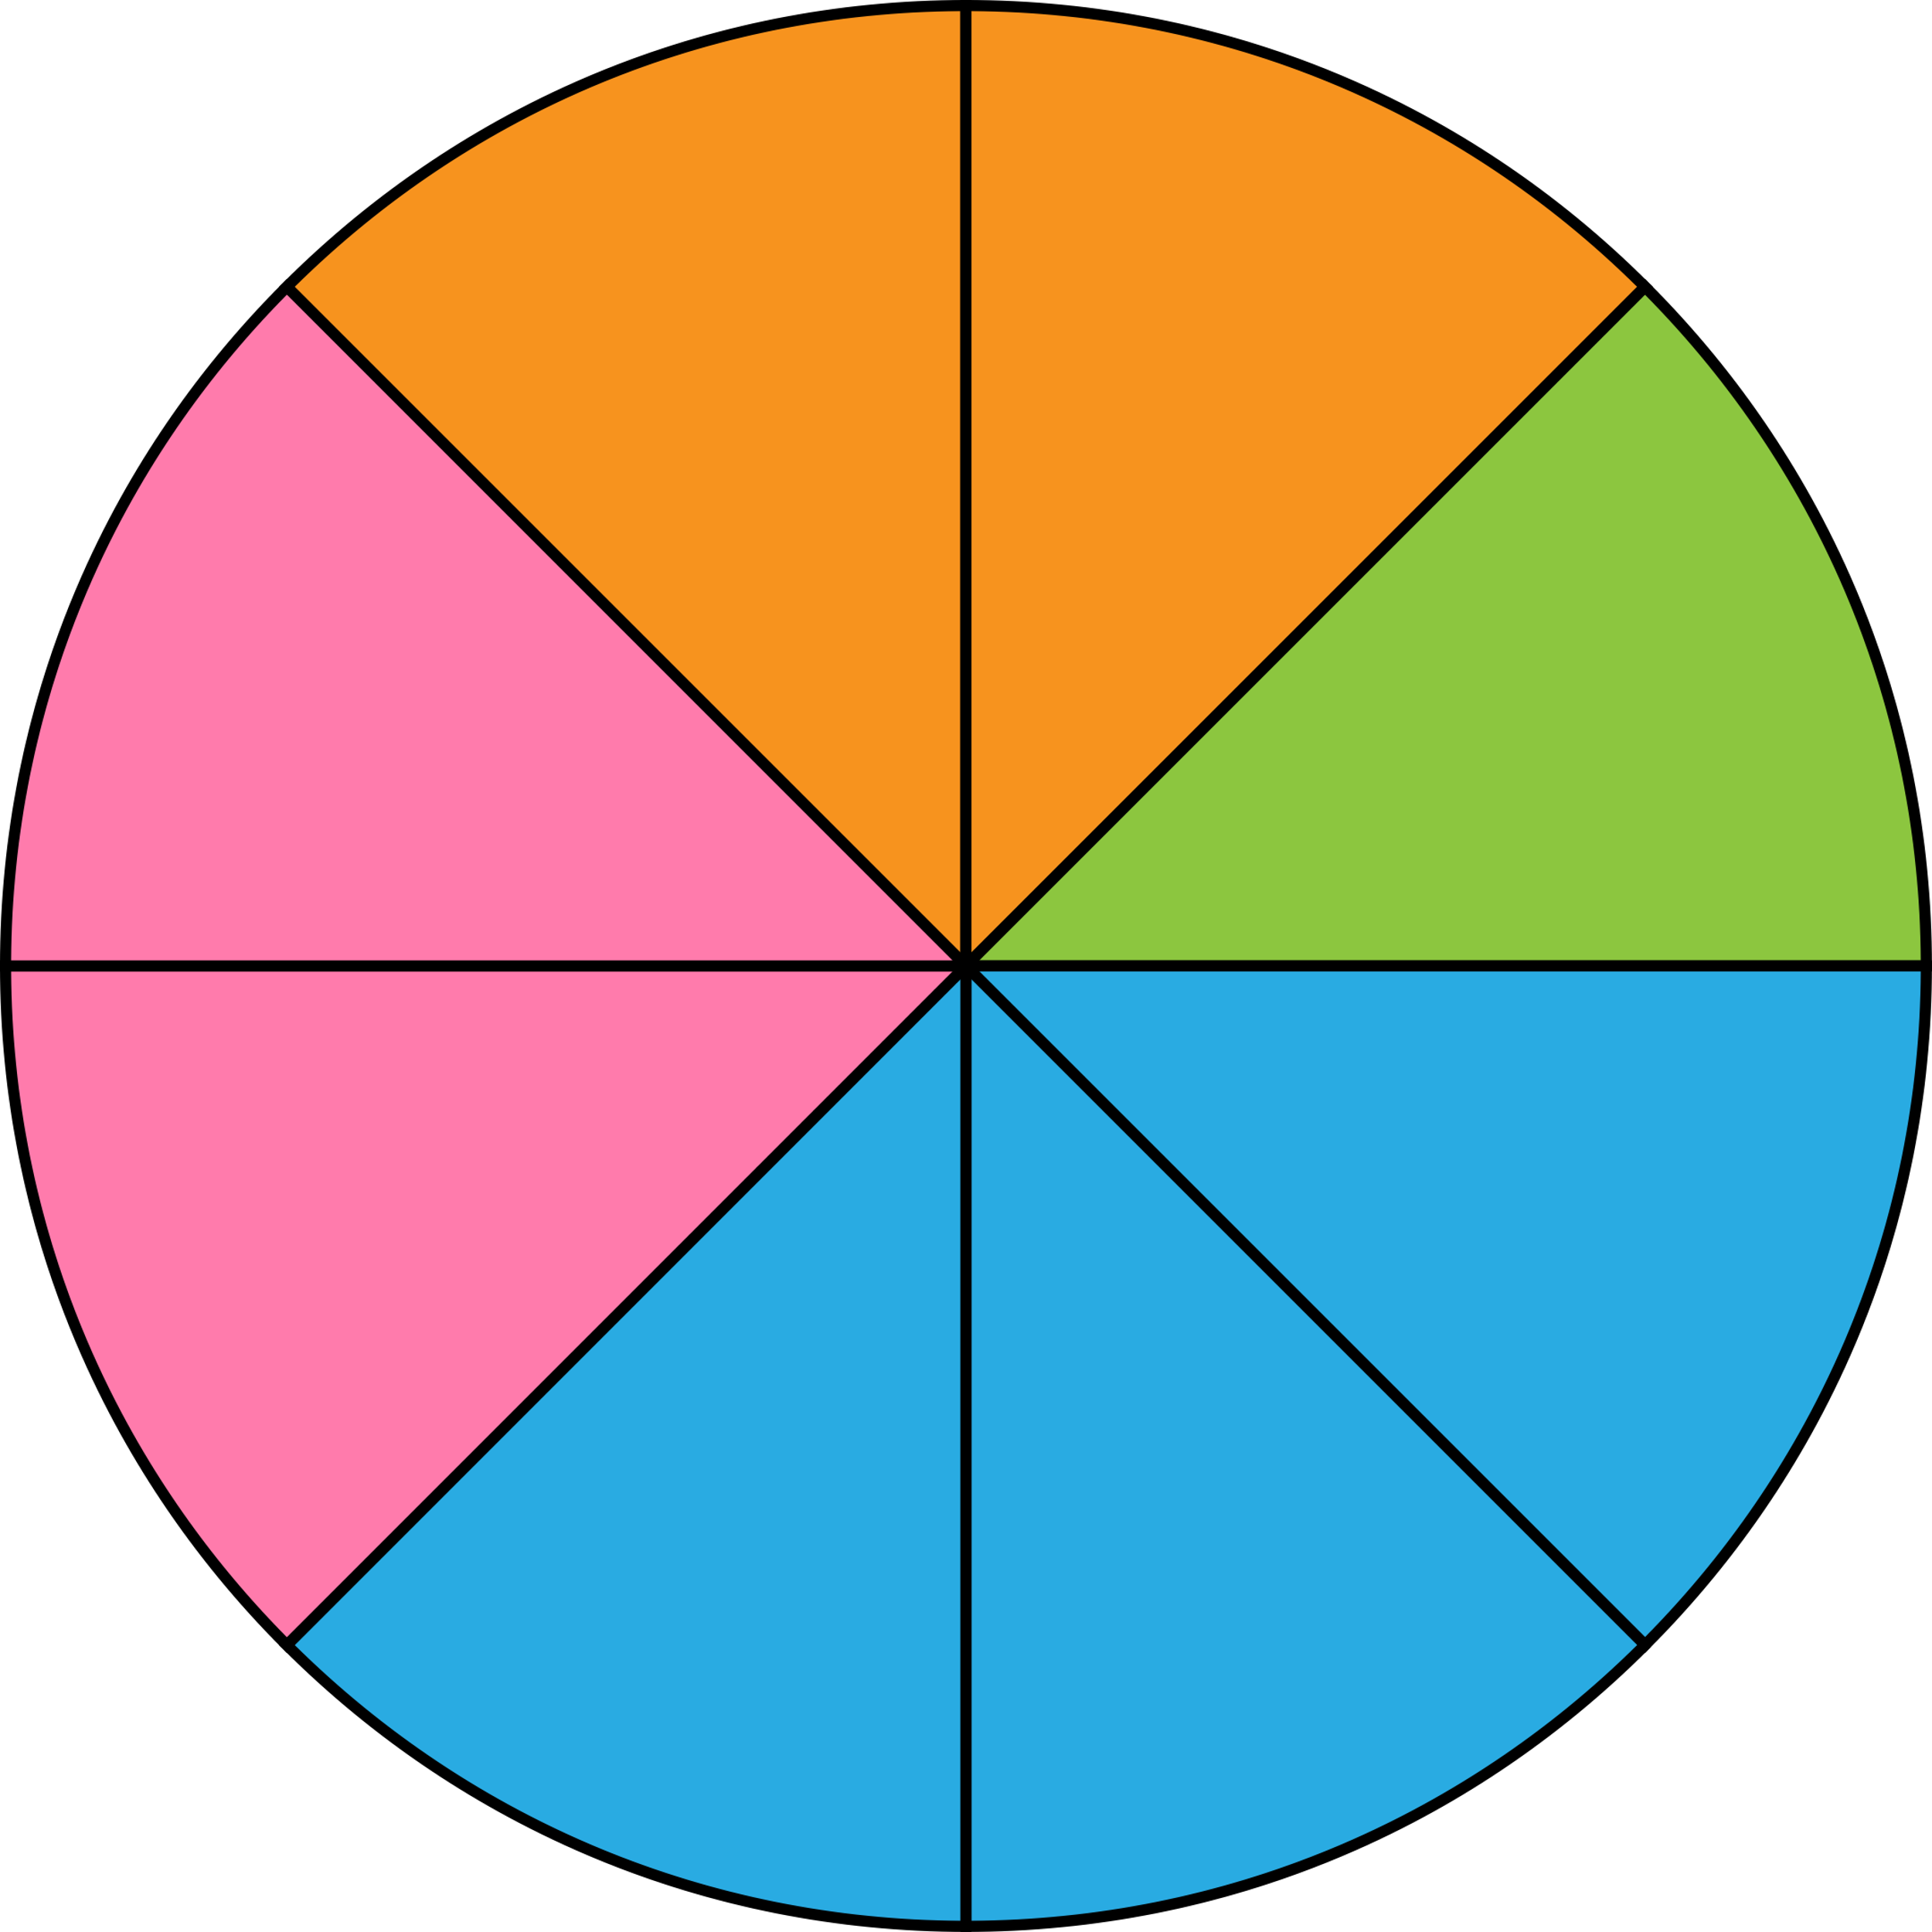
presentation ideas
Flow chart
Pictures on a line
Clock face

